Slide 1
Hotel Reservation
Management System

Slide 2
Abstract
The Hotel Reservation Management System is a MySQL-based database project developed to manage hotel operations efficiently. It stores and manages customer details, room information, bookings, payments, and reviews in a structured relational database.
The project uses SQL concepts such as Joins, Subqueries, Views, Window Functions, and Aggregate Functions to perform data management and generate useful reports. This system helps improve data organization, reduces redundancy, and ensures efficient hotel booking management.
The system enables users to manage hotel bookings, track room availability, record payment transactions, and maintain customer feedback. It also generates meaningful reports, such as booking details, payment reports, customer reviews, and room status, to support efficient hotel management and decision-making.
Overall, this project demonstrates the practical application of relational database concepts and SQL in designing a reliable, organized, and efficient hotel management system.

Slide 3
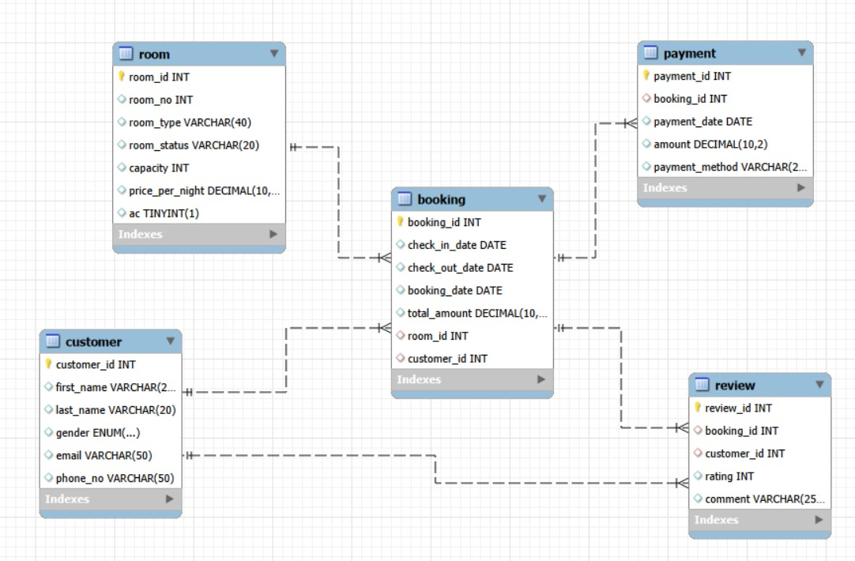
ER DIAGRAM

Slide 4
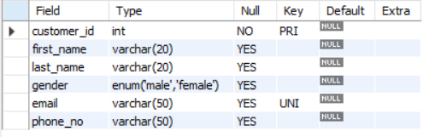
Structure of Customer Table
Customer Table
This Table Stores customer details such as name, gender, email, and phone number for hotel bookings.
Syntax : Desc Customer;

Slide 5
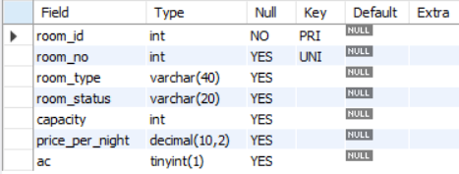
Structure of Room Table
Room Table
This Table Stores room details such as room number, type, status, capacity, price per night, and AC availability.
Syntax : Desc Room;

Slide 6
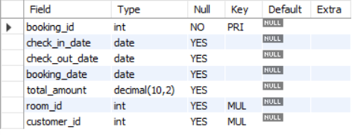
Structure of Booking Table
Booking Table
This Table Stores booking details, including check-in/check-out dates, booking date, total amount, and links customers with rooms.
Syntax : Desc Booking;

Slide 7
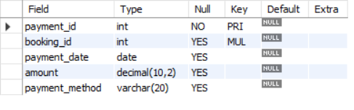
Structure of Payment Table
Payment Table
This Table Stores payment details, including payment date, amount, payment method, and the related booking.
Syntax : Desc Payment;

Slide 8
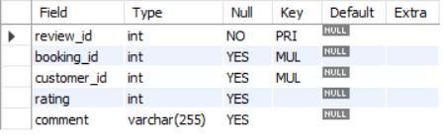
Structure of Review Table
Review Table
This Table Stores customer reviews, including ratings and comments, linked to their hotel bookings.
Syntax : Desc Review;

Slide 9
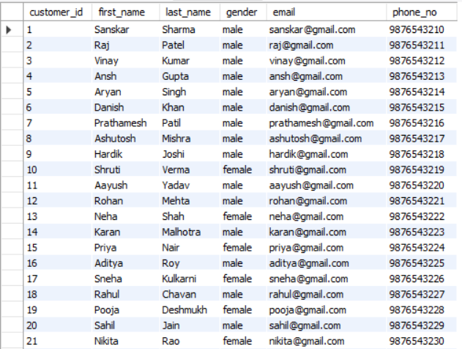
Contents of Customer Table
Syntax : Select * From Customer;

Slide 10
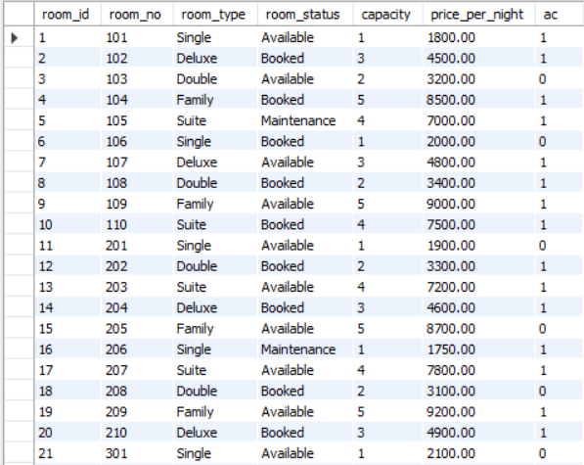
Contents of Room Table
Syntax : Select * From Room;

Slide 11
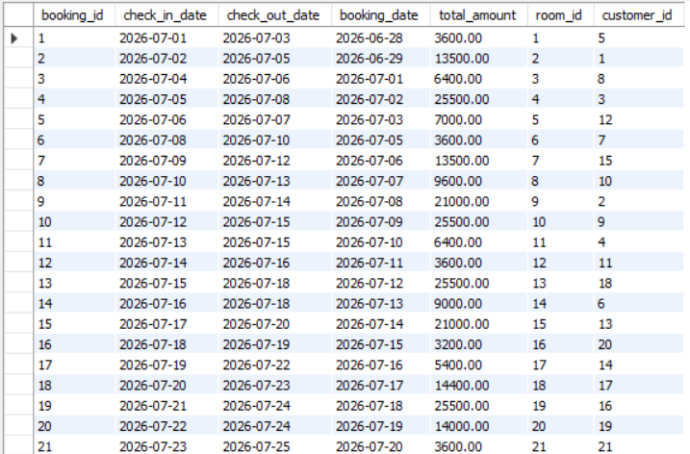
Contents of Booking Table
Syntax : Select * From
Booking;

Slide 12
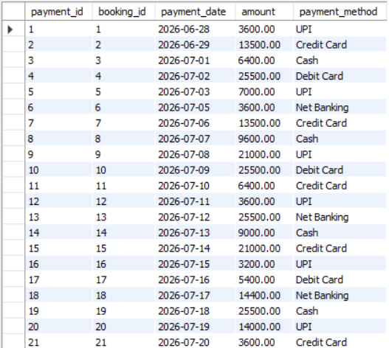
Contents of Payment Table
Syntax : Select * From Payment;

Slide 13
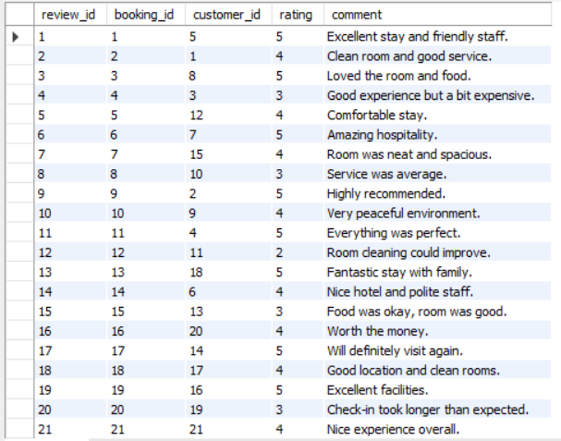
Contents of Review Table
Syntax : Select * From
Review;

Slide 14
JOINS

Slide 15
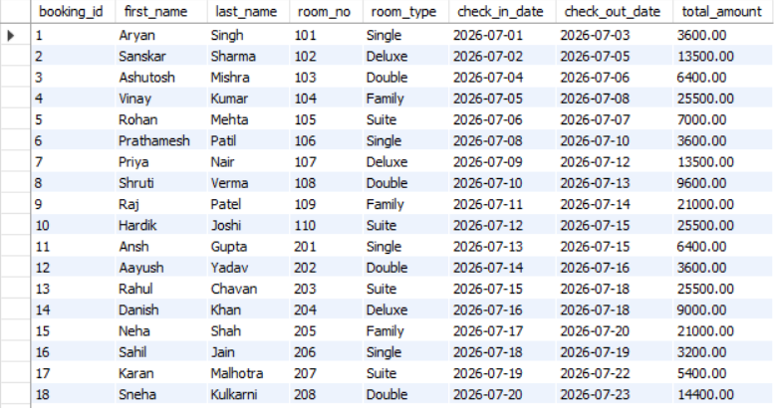
Joins
1.Generate a report showing customer details, room information, and booking details.
Query:
select b.booking_id , c.first_name , c.last_name ,r.room_no , r.room_type , b.check_in_date , b.check_out_date , b.total_amount
from booking b
join customer c on b.customer_id=c.customer_id
join room r
on r.room_id=b.room_id;

Slide 16
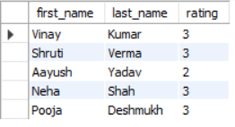
Joins
2.Show customers who gave ratings below or
equal to 3
Query:
select c.first_name,c.last_name ,
r.Rating from customer c
left join review r
on c.customer_id=r.customer_id
where r.rating<=3;

Slide 17
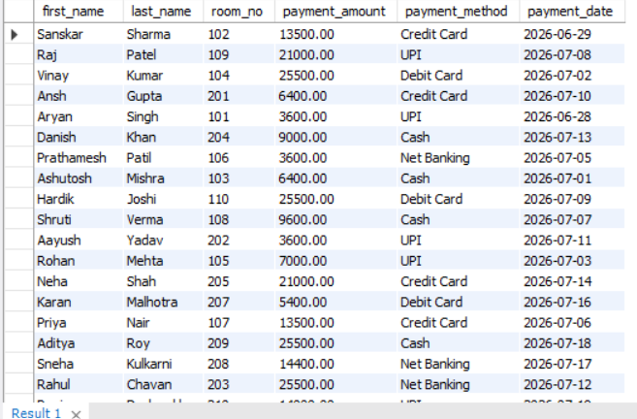
Joins
3.Show the payment details for each customer's hotel booking.
Query:
SELECT
c.first_name,c.last_name,
r.room_no,p.amount AS payment_amount,
p.payment_method,p.payment_date
FROM customer c
JOIN booking b
ON c.customer_id = b.customer_id
JOIN room r
ON r.room_id = b.room_id
JOIN payment p
ON p.booking_id = b.booking_id;

Slide 18
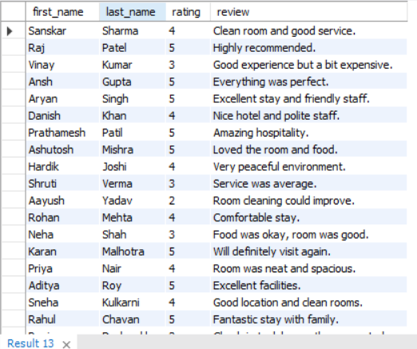
Joins
4.Display the customer details along with their ratings and review comments..
Query:
select
c.first_name , c.last_name ,r.rating , r.comment as review
from customer c join review r
on c.customer_id = r.customer_id;

Slide 19
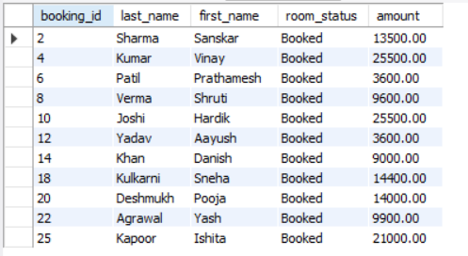
Joins
5.Generate a report of all confirmed bookings, including customer details, room information, and total charges.
Query:
select b.booking_id , c.last_name,
c.first_name ,
r.room_status , p.amount from
customer cjoin booking b
on c.customer_id=b.customer_id
join room ron r.room_id=b.room_id
join payment p
on p.booking_id = b.booking_id
where room_status='booked';

Slide 20
SUBQUERY

Slide 21
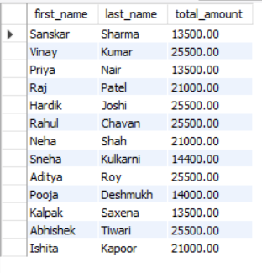
Subquery
6. Display the names of customers whose amount exceeds the average spending amount(using join).
Query: select c.first_name , c.last_name , b.total_amount from customer c
join booking b
on c.customer_id=b.customer_id
where b.total_amount> (select avg(total_amount) from booking);

Slide 22

Subquery
7.Display the most expensive room.
Query:
select room_no , room_type ,
Price_per_night
from room
where Price_per_night =
(select max(price_per_night) from room);

Slide 23
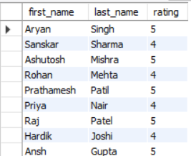
Subquery
8. Identify customers who gave the highest review rating.
Query:
select c.first_name , c.last_name , r.rating from customer c join review ron c.customer_id = r.customer_id
where r.rating in (select customer_id from booking where booking_id IN (select booking_id from review where rating = (select MAX(rating)from review)));

Slide 24
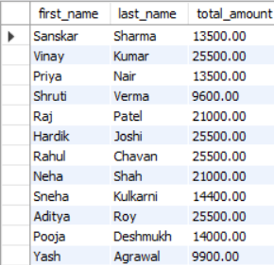
Subquery
9.Display the names of customers whose booking amount is greater than the booking amount of any customer who booked a Deluxe room.
Query:
select c.first_name, c.last_name, b.total_amountfrom customer cjoin booking bON c.customer_id = b.customer_id
where b.total_amount > any (select total_amount from booking where room_id in (select room_id from room where room_type = 'Deluxe'));

Slide 25
WINDOW
FUNCTION

Slide 26
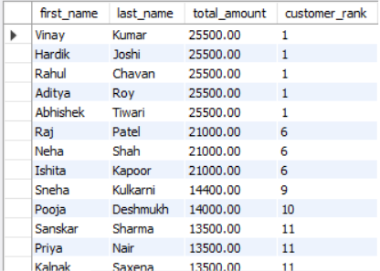
Window Function
10. Display customers ranked by their booking amount in descending order.
Query:
SELECT c.first_name, c.last_name, b.total_amount,
RANK() OVER (ORDER BY b.total_amount DESC) AS customer_rank FROM customer c JOIN booking b
ON c.customer_id = b.customer_id;

Slide 27
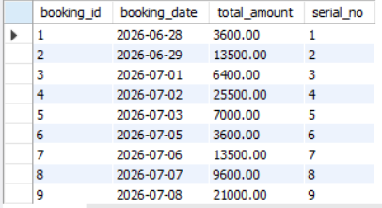
Window Function
11. Assign a serial number to each booking based on the booking date.
Query:
SELECT booking_id, booking_date, total_amount,
ROW_NUMBER()
OVER (ORDER BY booking_date)
AS serial_no FROM booking;

Slide 28
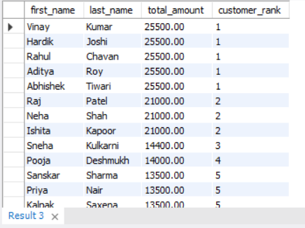
Window Function
14.Display customers ranked by their booking amount in descending order.
Query:
SELECT c.first_name, c.last_name, b.total_amount,
Dense_RANK() OVER (ORDER BY b.total_amount DESC) AS customer_rank FROM customer c JOIN booking b
ON c.customer_id = b.customer_id;

Slide 29
VIEW

Slide 30
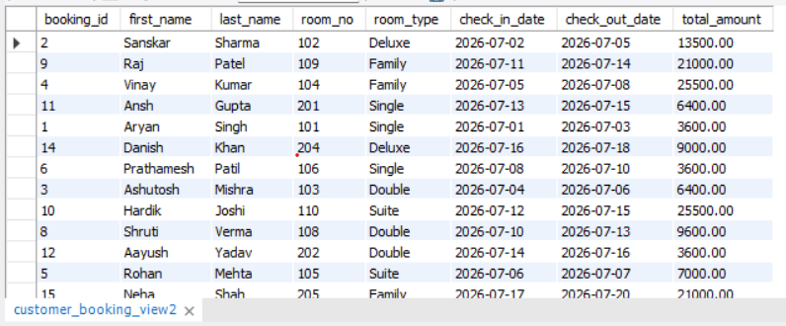
Views
13.Create a view to display complete booking details of customers.
Query:
CREATE VIEW customer_booking_view AS
SELECT
b.booking_id,c.first_name, c.last_name,
r.room_no, r.room_type, b.check_in_date, b.check_out_date, b.total_amount
FROM booking b
JOIN customer c
ON b.customer_id = c.customer_id
JOIN room r
ON b.room_id = r.room_id;

Slide 31
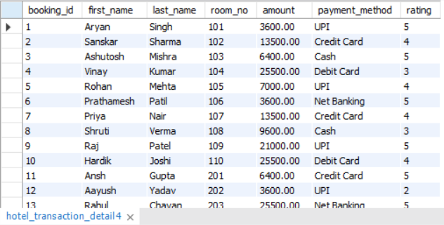
Views
14.Create a view to display complete booking details of customers.
Query:
CREATE VIEW hotel_transaction_detail AS SELECT b.booking_id, c.first_name, c.last_name, r.room_no, p.amount, p.payment_method, rv.ratingFROM booking bJOIN customer cON b.customer_id = c.customer_idJOIN room rON b.room_id = r.room_idJOIN payment pON b.booking_id = p.booking_idLEFT JOIN review rvON b.booking_id = rv.booking_id;

Slide 32
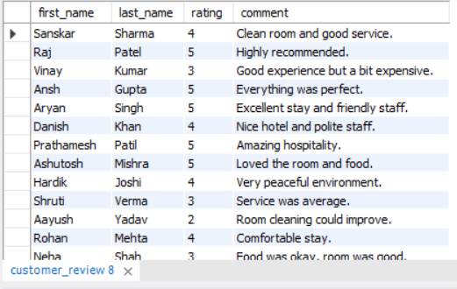
Views
15.Create a view to display customer feedback details.
Query:
CREATE VIEW customer_review AS
SELECT c.first_name, c.last_name, rv.rating, rv.commentFROM customer c
JOIN review rv
ON c.customer_id = rv.customer_id;

Slide 33
Prepared By:
Ronit Karmakar
IT-vedant — Data Science & Analytics with Artificial Intelligence T380
Hotel Reservation Management System Project

Slide 34
Thank You

